Slide 1
Java Training
14th - 15th Sep 2019

Slide 2
History of java
1 9 9 1 | James Gosling, Mike Sheridanand Patrick Naughton started Java language called Oak, named after a tree, took 18 months to develop. The name later changed to Green and then to Java
1 9 9 4 | Team refocussed the platform for World Wide Web Sun renamed Oak language to Java
1 9 9 5 | Sun Microsystem released the first public implementation as Java1.0a2 at SunWorld Conference It promised WORA (Write Once Run Anywhere) providing no cost run-times on popular platforms
1 9 9 6 | Formed JavaSoft group to develop the technology JDK (Java Development Kit) 1.0 was launched
1 9’9 8 | Rebranded as Java 2 Standard Edition
2 0’0’4 | Launch of J2SE 5.0
2 0 0 6 | Replaced the name J2SE with Java SE and dropped .0 from the version. Launched Java SE 6
2 0 1 1 | JAVA SE 7 - Added small language changes JVM extended with support for dynamic languages
2 0 1 8 | Major changes for Language level support and a new date time api inspired by Joda time

Slide 3
Java ARCHITECTURE
JDK: Java Development KIT It contains JRE and development tools like javac, javadoc etc;
JRE: Java Runtime Environment It contains set of libraries and tools for developing java application. It provides the minimum requirement for executing a java application
JVM(Java Virtual Machine) acts as a run-time engine to run Java applications. JVM is the one that actually calls the main method present in a java code. JVM is a part of JRE(Java Runtime Environment). Java applications are called WORA (Write Once Run Anywhere). This means a programmer can develop Java code on one system and can expect it to run on any other Java enabled system without any adjustment. This is all possible because of JVM.

Slide 4
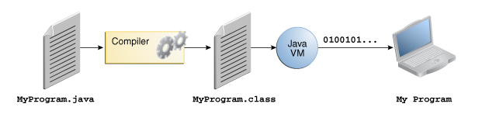
How Java Works?
Java is platform independence is achieved by the use of the Java Virtual Machine
A Java program consists of one or more files with a .java extension
When a Java program is compiled the .java files are fed to a compiler which produces a .class file for each .java file
The .class file contains Java bytecode.
Bytecode is like machine language, but it is intended for the Java Virtual Machine not a specific chip such as a Pentium or PowerPC chip

Slide 5
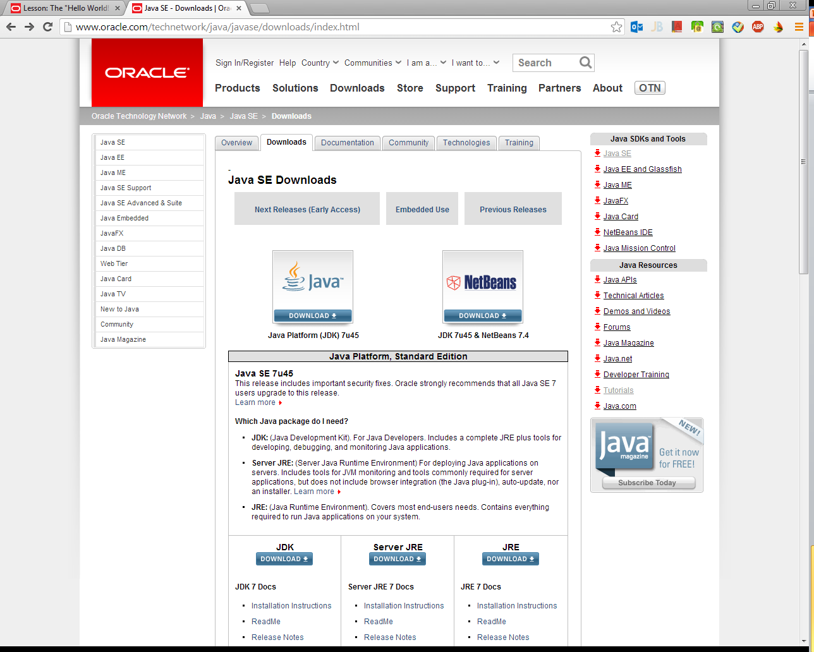
Installing Java
Downloading Java Development Kit (JDK) from Oracle
Java Runtime Environment (JRE) is usually included in the JDK installation file.

Slide 6
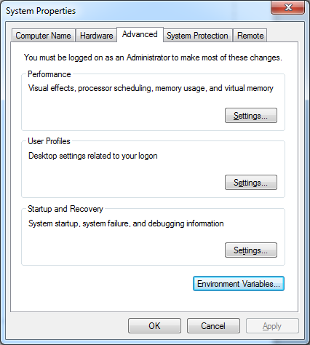
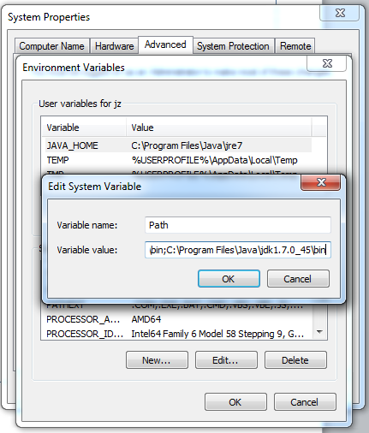
Setting JAVA_HOME (Windows) to <JAVA Installation folder> C:\Program Files\Java\jdk1.7.0_45
Setting path

Slide 7
JAVA QUICKSTART
In Java, every application begins with a class name, and that class must match the filename.
public class MyClass {
public static void main(String[] args) {
System.out.print("Hello, Welcome to Java Training");
}
}
To compile the code, type the following command on terminal:
$ javac MyClass.java
To run the compiled code, type:
$ java MyClass

Slide 8
Java Variables
Variables are containers for storing data values.
In Java, there are different types of variables, for example:
String - stores text, such as "Hello". String values are surrounded by double quotes
int - stores integers (whole numbers), without decimals, such as 123 or -123
float - stores floating point numbers, with decimals, such as 19.99 or -19.99
char - stores single characters, such as 'a' or 'B'. Char values are surrounded by single quotes
boolean - stores values with two states: true or false
Declaring (Creating) Variables
To create a variable, you must specify the type and assign it a value:
String name = “Alex”;
System.out.println(“My name is “ + name);
Some more examples ;
int myNum = 5;
float myFloatNum = 5.99f;
char myLetter = 'D';
boolean myBool = true;
String myText = "Hello";

Slide 9
Java Identifiers
All Java variables must be identified with unique names.
These unique names are called identifiers.
Identifiers can be short names (like x and y) or more descriptive names (age, sum, totalVolume).
The general rules for constructing names for variables (unique identifiers) are:
Names can contain letters, digits, underscores, and dollar signs
Names should begin with a letter
Names can also begin with $ and _ (but we will not use it in this tutorial)
Names are case sensitive ("myVar" and "myvar" are different variables)
Names should start with a lowercase letter and it cannot contain whitespace
Reserved words (like Java keywords, such as int or String) cannot be used as names

Slide 10
JAVA DATA TYPES
Primitive Data Types
A primitive data type specifies the size and type of variable values, and it has no additional methods.
There are eight primitive data types in Java:
Data Type | Size | Description
byte | 1 byte | Stores whole numbers from -128 to 127
short | 2 bytes | Stores whole numbers from -32,768 to 32,767
int | 4 bytes | Stores whole numbers from -2,147,483,648 to 2,147,483,647
long | 8 bytes | Stores whole numbers from -9,223,372,036,854,775,808 to 9,223,372,036,854,775,807
float | 4 bytes | Stores fractional numbers. Sufficient for storing 6 to 7 decimal digits
double | 8 bytes | Stores fractional numbers. Sufficient for storing 15 decimal digits
boolean | 1 bit | Stores true or false values
char | 2 bytes | Stores a single character/letter or ASCII values

Slide 11
Java operators
Operators are used to perform operations on variables and values.
The value is called an operand, while the operation (to be performed between the two operands) is defined by an operator:
Java divides the operators into the following groups:
Arithmetic operators
Assignment operators
Comparison operators
Logical operators
Arithmetic Operators
Arithmetic operators are used to perform common mathematical operations.

Slide 12
Java Assignment Operators
Assignment operators are used to assign values to variables.
In the example below, we use the assignment operator (=) to assign the value 10 to a variable called x: like :
int x = 10;
x+=5;

Slide 13
Java Comparison Operators
Comparison operators are used to compare two values:
Java Logical Operators
Logical operators are used to determine the logic between variables or values:

Slide 14
Java conditional constructs
Java has the following conditional statements:
Use if to specify a block of code to be executed, if a specified condition is true
Use else to specify a block of code to be executed, if the same condition is false
Use else if to specify a new condition to test, if the first condition is false
Use switch to specify many alternative blocks of code to be executed
Syntax :
if (condition) {
// block of code to be executed if the condition is true
} else {
// block of code to be executed if the condition is false
}
if (condition1) {
// block of code to be executed if condition1 is true
} else if (condition2) {
// block of code to be executed if the condition1 is false and condition2 is true
} else {
// block of code to be executed if the condition1 is false and condition2 is false
}
Java Switch Statements
Use the switch statement to select one of many code blocks to be executed.
Syntax :
switch(expression) {
case x:
// code block
break;
case y:
// code block
break;
default:
// code block
}

Slide 15
Java loops
Loops
Loops can execute a block of code as long as a specified condition is reached.
Java While Loop
The while loop loops through a block of code as long as a specified condition is true:
while (condition) {
// code block to be executed
}
The Do/While Loop
The do/while loop is a variant of the while loop. This loop will execute the code block once, before checking if the condition is true, then it will repeat the loop as long as the condition is true.
do {
// code block to be executed
}
while (condition);
Java For Loop
When you know exactly how many times you want to loop through a block of code, use the for loop instead of a while loop:
for (int i = 0; i < 5; i++) {
System.out.println(i);
}
Java Break
The break statement can also be used to jump out of a loop or switch
Java Continue
The continue statement breaks one iteration (in the loop), if a specified condition occurs, and continues with the next iteration in the loop.

Slide 16
Java Arrays
Arrays are used to store multiple values in a single variable, instead of declaring separate variables for each value.
To declare an array, define the variable type with square brackets:
String[] cars;
Declare a variable that holds an array of strings. To insert values to it, we can use an array literal - place the values in a comma-separated list, inside curly braces:
String[] cars = {"Volvo", "BMW", "Ford", “Mazda"};
To access the elements :
String[] cars = {"Volvo", "BMW", "Ford", "Mazda"};
System.out.println(cars[0]);
To change the array value:
cars[0] = “Opel";

Slide 17
Java Methods
A method is a block of code which only runs when it is called.
You can pass data, known as parameters, into a method.
Methods are used to perform certain actions, and they are also known as functions.
Why use methods? To reuse code: define the code once, and use it many times.
Call a Method
To call a method in Java, write the method's name followed by two parentheses () and a semicolon;
In the following example, myMethod() is used to print a text (the action), when it is called:
public class MyClass {
static void myMethod() {
System.out.println("I just got executed!");
}
public static void main(String[] args) {
myMethod();
}
}

Slide 18
Java class
Java Classes/Objects
JAva is an object-oriented programming language.
Everything in Java is associated with classes and objects, along with its attributes and methods. For example: in real life, a car is an object. The car has attributes, such as weight and color, and methods, such as drive and brake.
A Class is like an object constructor, or a "blueprint" for creating objects.
Create an Object
In Java, an object is created from a class. We have already created the class named MyClass, so now we can use this to create objects.
To create an object of MyClass, specify the class name, followed by the object name, and use the keyword new:
public class MyClass {
int x = 5;
public static void main(String[] args) {
MyClass myObj1 = new MyClass(); // Object 1
MyClass myObj2 = new MyClass(); // Object 2
System.out.println(myObj1.x);
System.out.println(myObj2.x);
}
}
Java Constructors
A constructor in Java is a special method that is used to initialize objects. The constructor is called when an object of a class is created. It can be used to set initial values for object attributes:

Slide 19
Java modifiers
The public keyword is an access modifier, meaning that it is used to set the access level for classes, attributes, methods and constructors.
We divide modifiers into two groups:
Access Modifiers - controls the access level
Non-Access Modifiers - do not control access level, but provides other functionality
For class you can use :
For attributes, methods you can use:
Non Access Modifiers are : final abstract, static.

Slide 20
Java package
A package in Java is used to group related classes. Think of it as a folder in a file directory. We use packages to avoid name conflicts, and to write a better maintainable code. Packages are divided into two categories:
Built-in Packages (packages from the Java API)
User-defined Packages (create your own packages)
The library is divided into packages and classes. Meaning you can either import a single class (along with its methods and attributes), or a whole package that contain all the classes that belong to the specified package.
To use a class or a package from the library, you need to use the import keyword:
import package.name.Class; // Import a single class
import package.name.*; // Import the whole package
import java.util.Scanner;
class MyClass {
public static void main(String[] args) {
Scanner myObj = new Scanner(System.in);
System.out.println("Enter username");
String userName = myObj.nextLine();
System.out.println("Username is: " + userName);
}
}

Slide 21
Java oops concepts
OOP concepts allow us to create specific interactions between Java objects. They make it possible to reuse code without creating security risks or making a Java program less readable.
Inheritance
Encapsulation
Abstraction
Polymorphism

Slide 22
Encapsulation
Encapsulation, is to make sure that "sensitive" data is hidden from users. To achieve this, you must:
declare class variables/attributes as private (only accessible within the same class)
provide public setter and getter methods to access and update the value of a private variable
public class Person {
private String name; // private = restricted access
// Getter
public String getName() {
return name;
}
// Setter
public void setName(String newName) {
this.name = newName;
}
}
Why Encapsulation?
Better control of class attributes and methods
Class variables can be made read-only (if you omit the set method), or write-only (if you omit the get method)
Flexible: the programmer can change one part of the code without affecting other parts
Increased security of data

Slide 23
Inheritance
In Java, it is possible to inherit attributes and methods from one class to another. We group the "inheritance concept" into two categories:
subclass (child) - the class that inherits from another class
superclass (parent) - the class being inherited from
To inherit from a class, use the extends keyword.
In the example below, the Car class (subclass) inherits the attributes and methods from the Vehicle class (superclass):
class Vehicle {
protected String brand = "Ford"; // Vehicle attribute
public void honk() { // Vehicle method
System.out.println("Tuut, tuut!");
}
}
class Car extends Vehicle {
private String modelName = "Mustang"; // Car attribute
public static void main(String[] args) {
// Create a myCar object
Car myCar = new Car();
// Call the honk() method (from the Vehicle class) on the myCar object
myCar.honk();
// Display the value of the brand attribute (from the Vehicle class) and the value of the modelName from the Car class
System.out.println(myCar.brand + " " + myCar.modelName);
}
}
Why And When To Use "Inheritance"?
- It is useful for code reusability: reuse attributes and methods of an existing class when you create a new class.

Slide 24
Polymorphism
The word polymorphism means having many forms. In simple words, we can define polymorphism as the ability of a message to be displayed in more than one form
In Java polymorphism is mainly divided into two types:
Compile time Polymorphism
Runtime Polymorphism
Compile time polymorphism: It is also known as static polymorphism. This type of polymorphism is achieved by function overloading or operator overloading.
Overloading
Overloading allows different methods to have the same name, but different signatures where the signature can differ by the number of input parameters or type of input parameters or both. Overloading is related to compile time (or static) polymorphism.
public class Sum {
// Overloaded sum(). This sum takes two int parameters
public int sum(int x, int y)
{
return (x + y);
}
// Overloaded sum(). This sum takes three int parameters
public int sum(int x, int y, int z)
{
return (x + y + z);
}
// Overloaded sum(). This sum takes two double parameters
public double sum(double x, double y)
{
return (x + y);
}
// Driver code
public static void main(String args[])
{
Sum s = new Sum();
System.out.println(s.sum(10, 20));
System.out.println(s.sum(10, 20, 30));
System.out.println(s.sum(10.5, 20.5));
}
}

Slide 25
Overriding
Polymorphism is one of the OOPs feature that allows us to perform a single action in different ways. For example, lets say we have a class Animal that has a method sound(). Since this is a generic class so we can’t give it a implementation like: Roar, Meow, Oink etc. We had to give a generic message.
public class Animal{
...
public void sound(){
System.out.println("Animal is making a sound");
}
}
public class Horse extends Animal{
...
@Override
public void sound(){
System.out.println("Neigh");
}
}
public class Cat extends Animal{
...
@Override
public void sound(){
System.out.println("Meow");
}
}

Slide 26
Abstraction & Interface
Abstraction
Abstraction aims to hide complexity from the users and show them only the relevant information. For example, if you want to drive a car, you don’t need to know about its internal workings. The same is true of Java classes. You can hide internal implementation details by using abstract classes or interfaces. On the abstract level, you only need to define the method signatures (name and parameter list) and let each class implement them in their own way.
abstract class Shape
{
String color;
// these are abstract methods
abstract double area();
public abstract String toString();
// abstract class can have constructor
public Shape(String color) {
System.out.println("Shape constructor called");
this.color = color;
}
// this is a concrete method
public String getColor() {
return color;
}
}

Slide 27
Collections
The Collection in Java is a framework that provides an architecture to store and manipulate the group of objects.

Slide 28
ArrayList
The ArrayList class implements the List interface. It uses a dynamic array to store the duplicate element of different data types. The ArrayList class maintains the insertion order and is non-synchronized. The elements stored in the ArrayList class can be randomly accessed. Consider the following example.
import java.util.*;
class TestJavaCollection1{
public static void main(String args[]){
ArrayList<String> list=new ArrayList<String>();//Creating arraylist
list.add("Ravi");//Adding object in arraylist
list.add("Vijay");
list.add("Ravi");
list.add("Ajay");
//Traversing list through Iterator
Iterator itr=list.iterator();
while(itr.hasNext()){
System.out.println(itr.next());
}
}
}

Slide 29
Set Interface
Set Interface in Java is present in java.util package. It extends the Collection interface. It represents the unordered set of elements which doesn't allow us to store the duplicate items. We can store at most one null value in Set. Set is implemented by HashSet, LinkedHashSet, and TreeSet
HashSet
HashSet class implements Set Interface. It represents the collection that uses a hash table for storage. Hashing is used to store the elements in the HashSet. It contains unique items.
import java.util.*;
public class TestJavaCollection7{
public static void main(String args[]){
//Creating HashSet and adding elements
HashSet<String> set=new HashSet<String>();
set.add("Ravi");
set.add("Vijay");
set.add("Ravi");
set.add("Ajay");
//Traversing elements
Iterator<String> itr=set.iterator();
while(itr.hasNext()){
System.out.println(itr.next());
}
}
}

Slide 30
HashMap class
Java HashMap class implements the map interface by using a hash table. It inherits AbstractMap class and implements Map interface.
◦ Java HashMap class contains values based on the key.
◦ Java HashMap class contains only unique keys.
◦ Java HashMap class may have one null key and multiple null values
◦ Java HashMap class maintains no order.
import java.util.*;
public class HashMap2 {
public static void main(String args[]) {
HashMap<Integer,String> map=new HashMap<Integer,String>();
map.put(100,"Amit");
map.put(101,"Vijay");
map.put(102,"Rahul");
map.put(103, "Gaurav");
System.out.println("Initial list of elements: "+map);
//key-based removal
map.remove(100);
System.out.println("Updated list of elements: "+map);
//value-based removal
map.remove(101);
System.out.println("Updated list of elements: "+map);
//key-value pair based removal
map.remove(102, "Rahul");
System.out.println("Updated list of elements: "+map);
}
}

Slide 31
HashTable
Java Hashtable class implements a hashtable, which maps keys to values. It inherits Dictionary class and implements the Map interface.
Points to remember
◦ A Hashtable is an array of a list. Each list is known as a bucket. The position of the bucket is identified by calling the hashcode() method. A Hashtable contains values based on the key.
◦ Java Hashtable class contains unique elements.
◦ Java Hashtable class doesn't allow null key or value.
◦ Java Hashtable class is synchronized.
import java.util.*;
class Hashtable1{
public static void main(String args[]){
Hashtable<Integer,String> hm=new Hashtable<Integer,String>();
hm.put(100,"Amit");
hm.put(102,"Ravi");
hm.put(101,"Vijay");
hm.put(103,"Rahul");
for(Map.Entry m:hm.entrySet()){
System.out.println(m.getKey()+" "+m.getValue());
}
}
}

Slide 32
Exceptions
An exception (or exceptional event) is a problem that arises during the execution of a program. When an Exception occurs the normal flow of the program is disrupted and the program/Application terminates abnormally, which is not recommended, therefore, these exceptions are to be handled.
Catching Exceptions
A method catches an exception using a combination of the try and catch keywords. A try/catch block is placed around the code that might generate an exception. Code within a try/catch block is referred to as protected code, and the syntax for using try/catch looks like the following −
try {
// Protected code
} catch (ExceptionName e1) {
// Catch block
}
try {
file = new FileInputStream(fileName);
x = (byte) file.read();
} catch (IOException i) {
i.printStackTrace();
return -1;
} catch (FileNotFoundException f) {
f.printStackTrace();
return -1;
}

Slide 33
The Throws/Throw Keywords
If a method does not handle a checked exception, the method must declare it using the throws keyword. The throws keyword appears at the end of a method's signature.
You can throw an exception, either a newly instantiated one or an exception that you just caught, by using the throw keyword.
Try to understand the difference between throws and throw keywords, throws is used to postpone the handling of a checked exception and throw is used to invoke an exception explicitly.
The following method declares that it throws a RemoteException −
import java.io.*;
public class className {
public void deposit(double amount) throws RemoteException {
// Method implementation
throw new RemoteException();
}
// Remainder of class definition
}
The Finally Block
The finally block follows a try block or a catch block. A finally block of code always executes, irrespective of occurrence of an Exception.
Using a finally block allows you to run any cleanup-type statements that you want to execute, no matter what happens in the protected code.
A finally block appears at the end of the catch blocks and has the following syntax −
try {
// Protected code
} catch (ExceptionType1 e1) {
// Catch block
} catch (ExceptionType2 e2) {
// Catch block
} catch (ExceptionType3 e3) {
// Catch block
}finally {
// The finally block always executes.
}

Slide 34
User-defined Exceptions
You can create your own exceptions in Java. Keep the following points in mind when writing your own exception classes −
All exceptions must be a child of Throwable.
If you want to write a checked exception that is automatically enforced by the Handle or Declare Rule, you need to extend the Exception class.
If you want to write a runtime exception, you need to extend the RuntimeException class.
We can define our own Exception class as below −
class MyException extends Exception {
}

